Slide 1

Test design techniques

Slide 2
topics
Identifying test conditions and designing test cases
Categories of test design techniques
Specification-based or Black-box techniques
Structure-Based or White-box techniques
Experience-Based Techniques
Choosing a Test Technique

Slide 3
Identifying test conditions & designing test cases
Before executing tests we need to know:
  What we are testing
  What inputs are required
  Expected Results
  How to prepare and run the tests
Test conditions are documented in a Test Design Specification
Test Cases are documented in a Test Case Specification
Test Procedures are documented in a Test Procedure Specification (Test scripts or manual test scripts)

Slide 4
Formality of Test documentation
Testing has varying degrees of formality
  Formal Testing = high amount of documentation
  Informal testing = low amount of documentation
The right degree of formality depends on the context of the test – What testing principle is being applied here?
Level of formality is also influenced by the organization
  Maturity of the development process
  Maturity of the testing process
Thoroughness of your testing documentation can depend on various constraints
  Time
  Money

Slide 5
Test analysis: Identifying test conditions
Test Analysis: Process of looking at something that can be used to derive test information
This basis for the tests is called the test basis
  System Requirement
  Business Process
  Experience
We look at the Test Basis to see what could be tested
Test Condition: Something that we can test
  If we are looking at coverage of code decisions (branches), the test basis can be the code itself
    The Test Conditions would be the decision outcomes (T or F)
  If we have a requirement specification, the table of contents can be our initial list of test conditions
A good way to understand requirements better is to try to define tests to meet those requirements
When identifying test conditions, we want to make sure we can identify as many conditions as possible and then narrow the list
  Why?? What Testing Principle is being applied here?

Slide 6
More on identifying test conditions
Since we can’t test everything, we need to select a subset of possible test conditions
The subset we select may be small, but it must have a high probability of finding the most defects in the system
We need an intelligent thought process to guide our selection – This thought process is called Test Technique
Test Design Techniques: Procedures used to derive and/or select test cases
Different techniques provide different ways of looking at the AUT
Test conditions that are chosen will depend on the test strategy or test approach
Traceability: Test conditions should be linked back to their sources in the test basis

Slide 7
Why is traceability important
Consider these examples:
  Requirements for a given function or feature have changed so now some fields have different ranges of inputs to be entered.
    Which tests were aimed at these boundaries which need to be changed?
    How many tests are affected by the change in the requirements?
    These questions can be answered if the tests are traced back to the requirements
  A set of tests that have previously passed, but now start to fail
    What functionality do they test?
    We can identify the functionality easily if there is traceability
  We want to know whether or not we have tested all of the specified requirements
    We can determine if we’ve done enough testing if there is a traceability matrix

Slide 8
Little more on identifying test conditions
Once we identify test conditions, we need to prioritize them so the most important test conditions are identified
  We want to efficiently allocate our time while designing our test cases for the important test conditions
  We don’t want to waste time implementing poor tests
Test conditions can be identified for test data, test inputs, and test outcomes
The test data should be designed to represent the most important types of data (the most important data conditions)

Slide 9
Test design: specifying test cases
Test Conditions can be vague, but test cases must be precise
To create Test Cases, we need exact and specific inputs
  John Doe, Age 17, Location: Fairfax, VA, Expected Result: Added to South east regional Marketing campaign roster
If you don’t know what the system is supposed to do with the inputs, you can’t tell whether it passed or failed
Test cases can be documented as described in the IEEE 829 Standard for Test Documentation
  Not required, but it provides a set of guidelines to follow when designing test documentation
One of the most important aspects of a test is that it assesses that the system does what it’s supposed to do
In order to know what the system should do, we need to have a source of information about the correct behavior of the system – oracle or test oracle
Once an input value has been chosen, the tester must identify what the expected result should be of entering that input and document it in the test case
Expected Results should be determined before executing the tests

Slide 10
More on specifying test cases
The test case should also specify why it exists
  The objective (purpose) of the test
Test cases need to be detailed so that we can accurately check the results and know that we have exactly the right response from the system
If the tests are to be automated, the tool needs to know exactly what to compare the system outputs to

Slide 11
Test Implementation: Specifying Test procedures or Scripts
After designing the tests, we need to group them in a sensible way for executing them and to specify the sequential steps that need to be followed to run the tests
Some test cases may need to be run in a specific order
Test Procedure: Document that describes the steps to be taken in running a set of tests
  Specifies the executable order of the tests
  AKA Test Script
Test procedures or Scripts are then formed into a test execution schedule that specifies which procedures are to be run first
The logical and technical dependencies between scripts would also be taken into account when scheduling the scripts
  Example: A regression test would always be run 1st when a new release arrives as a smoke test or a sanity check

Slide 12
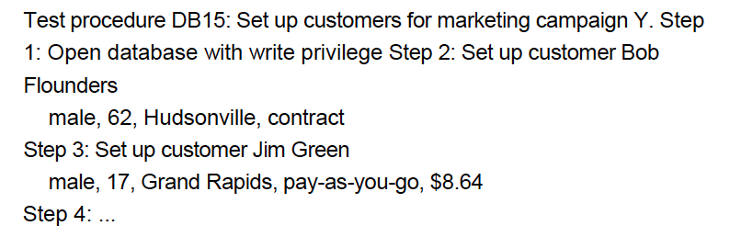
More of specifying test procedures/scripts
Example of test procedure:
Writing test procedures is another way to prioritize tests, to ensure that the best testing is done in the time available
Rule of thumb: Find the scary stuff first
  ‘Scary’ – depends on the business, system, or project

Slide 13
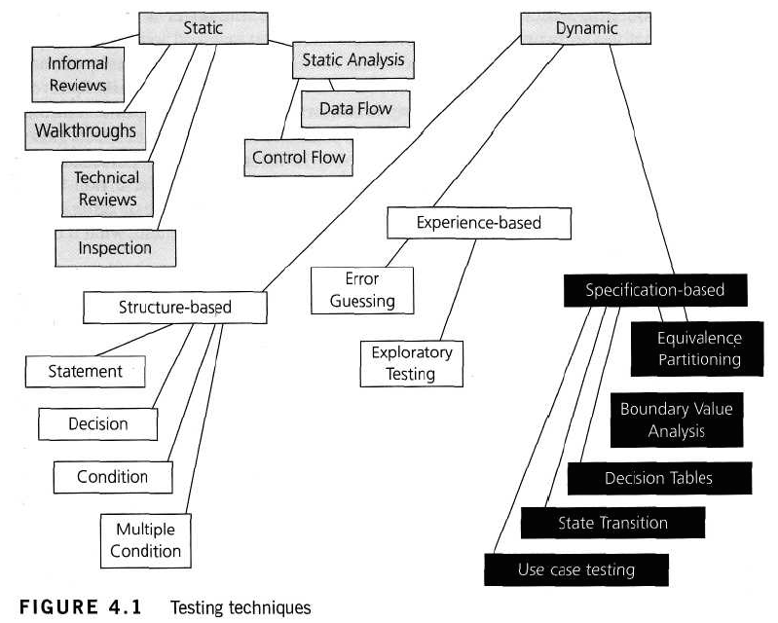
Categories of test design techniques

Slide 14
Static Testing Techniques
Static Testing doesn’t execute any code
Generally done before any tests are done on the software
Used to ‘test’ any document including source code, design documents, functional specifications and requirement specifications
Static Analysis – tool-supported type of static testing that concentrates on testing formal languages and so is often used to statically test source code

Slide 15
Specification-bAsed Techniques
AKA Black-box techniques or input-output driven testing techniques because they view the software as a black box with inputs and outputs, but have no knowledge of the internal code
Consists of both functional and non-functional testing
Functional testing – concerned with what the system does
Non-functional testing – concerned with determining how well the system does something

Slide 16
Structure-Based Techniques
AKA White-box techniques or glass-box techniques
Dynamic instead of static
Use the internal structure of the software to derive the test cases
Testers have knowledge of the internal workings of the software
Structural technique would be concerned with exercising loops in the software
Different test cases could be derived to execute the loop once, twice, and many times
Done regardless of the functionality of the software

Slide 17
Experience Based Techniques
Experience Based Techniques: based on people’s knowledge, skills, and background to determine test conditions and test cases
The experience of both the technical and business people is important because they both provide different perspectives to the test analysis and design process
Due to previous experience with similar systems, they may have insights into what could go wrong, which is very useful for testing

Slide 18
Where to apply the different categories of techniques
Specification-Based techniques are appropriate at all levels of testing where a specification exists
  Component testing through Acceptance Testing
  These specifications form the test basis
Structure-Based techniques can be used all levels of testing
  Developers use structure-based techniques in component and component-integration testing
  Also used in system and acceptance testing, but the structures are different
    Example: the coverage of menu options or major business transactions could be structural element in system or acceptance testing
Experience-based techniques are used to complement specification-based and structure-based techniques
  Also used when there are no specifications or specifications are inadequate
  This may be the only type of technique used for low-risk systems
  Useful under extreme time pressure

Slide 19
Specification-Based or Black-Box Techniques
4 types of specification based techniques:
  Equivalence Partitioning
  Boundary Value Analysis
  Decision Tables
  State Transition Testing

Slide 20
Equivalence Partitioning
Equivalence Partitioning: A black-box test design technique in which test cases are designed to execute representatives from equivalence partitions. Test cases are generally designed to cover each partition at least once.
  Idea is to divide (to partition) a set of test conditions into groups or sets that can be considered the same (i.e. the system should handle them equivalently)
  Equivalence Partitions: AKA Equivalence Classes
  We only need to test 1 condition from each partition because we assume that all of the conditions in a given partition will have the same result
Example: Savings account offers different interest rate depending on the account balance. In order to test the software that calculates the interest due, we can identify the ranges of balance values that earn different rates.
We have 3 Equivalence Partition Tests
  $50.45, $405.00, $1485.83

Slide 21
Boundary Value Analysis
Boundary Value Analysis: (BVA) Based on testing at the boundaries between partitions
We will have both valid boundaries (in the valid partitions) and invalid boundaries (in the invalid partitions)
Boundary values are defined as those values on the edge of a partition, we have identified the following boundary values:
  -$0.01 (invalid boundary value)
  $0.00, $100.00, $100.01, $999.99, & $1,000.00 (valid boundaries)
By applying BVA, we have 6 tests for boundary values

Slide 22
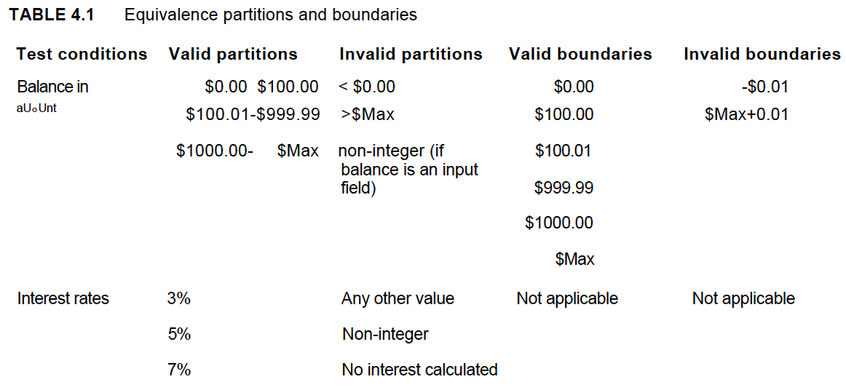
Open Boundary

Slide 23
Open Boundaries
Open Boundary: 1 side of a partition is left open (not defined)
  Still needs to be tested somehow!
Best solution is to find out what the boundary should be specified as
  Look at the specification to see if a maximum has been stated somewhere else
  Investigate other related areas of the system
    Example: The field that holds the account balance has room for only 6 digits plus 2 decimal places ($xxx,xxx.xx). So we can use $999,999.99 as the maximum boundary value
If no approach helps us define the maximum boundary, then we should turn to an experience-based approach to throw various large values in the hopes that it fails

Slide 24
More on EP and BVA
When trying to identify a defect, you might try several values in a partition.
  If this results in different behavior when you expected the same behavior, then there may be more than 1 partition
We can apply EP and BVA to all levels of testing
  System Level Example:
    3 basic configurations which the users can choose from (System Admin, Manager, & Customer Liaison)
      These are 3 EPs that could be tested
EP and BVA can be applied more than once to the same specification item
  Example: Internal phone system for a business with 200 telephones has 3-digit extension numbers from 100-699, we have the following partitions:
    Digits (0-9) with the invalid partition containing non-digits
    Number of digits, 3 (so invalid boundary value of 2 and 4 digits)
    Range of extension numbers, 100-699 (so invalid boundary values of 099 and 700)
    Extensions that are in use and those that are not (2 valid partitions, no boundaries)
    The lowest and highest extension numbers that are in use could also be used as boundary values
  Test case using extension 409, which is in use would test 4 valid partitions:
    Digits
    Number of Digits
    The valid Range
    ‘in-use’ partition
    Also tests the boundary values for digits 0 and 9

Slide 25
Telephone example continued
How many test cases would we need to test all of the valid and invalid partitions and boundaries?
We would need:
  A non-digit test case
  A 2-digit test case
  A 4-digit test case
  Extension 99
  Extension 100
  Extension 699
  Extension 700
  1 extension that is not in use
  And possibly the lowest and highest extensions in use
This is 9 or 10 test cases – exact number would depend on what test cases we can combine
Remember our example from last week about the 1-digit input field?
  We said then that we would need around 68 test cases just to test that 1-digit field thoroughly!
EP and BVA helps us to identify tests that are most likely to find defects and to use fewer test cases to find them

Slide 26
Some more on EP & BVA
BVA can be applied to an entire string of characters (name or address)
  Number of characters in a string is a partition
    Between 1 and 30 characters is the valid partition
    Valid boundaries of 1 and 30
    Invalid boundaries would be 0 characters and 31 characters
      Both should produce an error
Partitions can also be identified when setting up test data
  If there are different types of records, your testing will be more representative if you include a data record of each type
  The size of a record would also be a partition with boundaries
With BVA, we think of the boundaries as a dividing line between 2 things
  We have a value on either side of the boundary, but the boundary itself is not a value

Slide 27
Designing test cases
Once test conditions have been identified (using EP & BVA), next step is to design our test cases
The more test conditions that can be covered by a single test case, the fewer test cases we’ll have
  Best for positive tests and for tests that you are fairly confident will pass
We need to have a good balance between covering too many and too few test conditions in a single test case

Slide 28
1 test case covers multiple conditions
Using the bank balance example from before:
  1st test could be of a new customer with a balance of $500
    This would cover a balance in the partition from $100.01 to $999.99 and an output of a 5% interest rate
    Also covering partitions not yet mentioned – a valid customer, a new customer, customer with only 1 account, etc.
    All partitions covered in this test case are valid partitions
  To test invalid partitions, best option is to cover only 1 invalid test condition per test.
    Reason: If you combine multiple invalid test conditions, and the test fails, it will be hard to determine which test condition cause the failure
      Example: you log in and system tells you you’re user name and/or password is incorrect…but doesn’t tell you which 1…UGH!!!
  To cover the boundary tests, it’s possible to include all minimum boundaries for all inputs in 1 test and all maximum boundaries for all inputs in another test

Slide 29
When EP & bva are not enough
EP & BVA are often applied to specific situations or inputs
However, if different combinations of inputs result in different actions being taken, this can be more difficult to show using EP & BVA
EP & BVA tend to be more focused on the user interface
The other two specification-based testing techniques are:
  Decision Tables
  State Transition Testing

Slide 30
Decision table testing – Why use decision tables?
Decision Table: A good way to deal with combinations of things (inputs)
  Sometimes referred to as ‘cause-effect’ table
Cause-Effect Graphing: Associated logic diagramming technique which is sometimes used to help derive decision tables
Decision Tables provide a systematic way of stating complex business rules, which is useful for developers as well as testers
They can be used in test design as they help testers explore the effects of combinations of different inputs and other software states that must correctly implement business rules
We have to be satisfied with testing just a small subset of combinations but making the choice of which combinations to test and which to leave out is not trivial
  We need a logical method to select these combinations
Decision Tables aid the systematic selection of effective test cases and have the added positive side-effect of finding problems and ambiguities in the specifications

Slide 31
Using decision tables for test design
1st task is to identify a suitable feature that has a behavior which reacts according to a combination of inputs or events
After identifying the aspects that need to be combined, put them in a table listing all the combinations of TRUE or FALSE for each of the aspects
Example: IF you are a new customer and you want to open a credit card account than there are three conditions:
  1st Condition: You will get 15% discount on all your purchases today
  2nd Condition: If you are an existing customer and you hold a loyalty card, you get a 10% discount
  3rd Condition: If you have a coupon, you can get 20% off today (but it can’t be used with the ‘new customer’ discount)
  Discount amounts are added if applicable

Slide 32
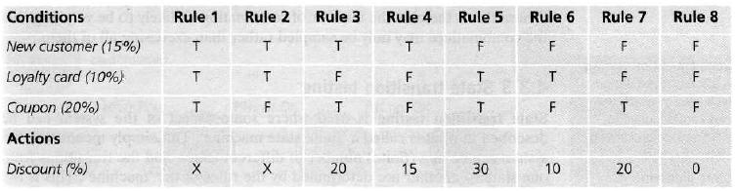
Decision tables - Credit Card example
The Conditions and actions are listed in the left-hand column.
All other columns in the decision table each represent a separate rule, 1 for each combination of conditions
We may choose to test each rule/combination and if there are only a few this will usually be the case
However, if the number of rules/combinations is large, we are more likely to sample them by selecting a rich subset for testing

Slide 33
Note that we have put ‘X’ for the discount for 2 of the columns (rules 1 and 2)
  This means that this combination should not occur
  You cannot be both a new customer and also holding a loyalty card
  Hence there should be an error message stating this
We have made an assumption in Rule 3.
  Since the coupon has a greater discount than the new customer discount,
  we assume the customer will choose 20% rather than 15%.
  We can’t add them, since the coupon can’t be used with ‘new customer’
  discount as stated in the conditions mentioned earlier.
  The 20% action is an assumption on our part, and we should check that this
  assumption (and any other assumptions we make) is correct, by asking the
  person who wrote the specification or the users
For Rule 5, however, we can add the discounts; since both the coupon and the loyalty
card discount should apply (that’s our assumption)
Rules 4, 6, & 7 have only 1 type of discount and Rule 8 has no discount, so 0%

Slide 34
More on Decision Tables
If we apply this technique thoroughly, we would have 1 test for each column or rule of our decision table
The advantage of doing this is that we may test a combination of things that otherwise we might not have tested and that could find a defect
Don’t just assume that all combinations need to be tested
It’s always better to prioritize and test the most important combinations
Having the full table helps us to decide which combinations we should test and which not to test this time

Slide 35
State transition testing
State Transition Testing: Used where some aspect of the system can be described in what is called a ‘finite state machine’
  The system can be in a finite number of different states, and the transitions from 1 state to another are determined by the rules of the ‘machine’
Any system where you get a different output for the same input, depending on what has happened before, is a finite state system
A finite state system is often shown as a state diagram
One of the advantages of the state transition technique is that the model can be as detailed or as abstract as you need it to be.
  Where a part of the system is more important (requires more testing) a greater depth of detail can be modeled.
  Where the system is less important (requires less testing), the model can use a single state to signify what would otherwise be a series of different states

Slide 36
State Transition Model
4 basic parts:
  The states that the software may occupy
    Open/Closed
    Funded/insufficient funds
  The transitions from 1 state to another
    Not all transitions are allowed
  The events that cause a transition
    Closing a file
    Withdrawing money
  The actions that result from a transition
    An error message
    Being given your cash
We can see that in any given state, 1 event can cause only 1 action, but that the same event – from a different state – may cause a different action and a different end state
Example: If you request to withdraw $100 from an ATM
  You may be given cash
  Later you can make the same request, but it may be refused because of insufficient funds
    This later refusal is because the state of your bank account has changed from having sufficient funds to having insufficient funds
  The transaction that caused your account to change its state was probably the earlier withdrawal
  A state diagram can represent a model from the point of view of the system, the account, or the customer

Slide 37
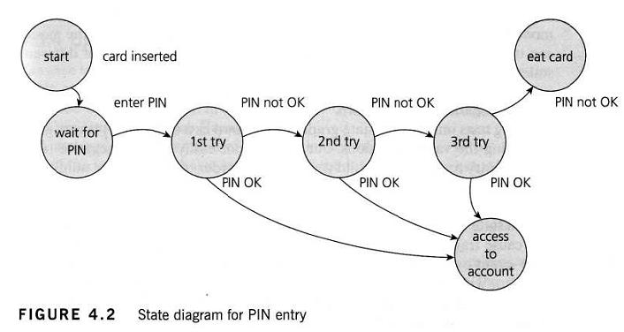
State transition model – another example
1st Test Case: Correct PIN is entered the 1st time
2nd Test Case: (visit every state) Enter an incorrect PIN each time, so that the system
eats the card
3rd Test Case: PIN was incorrect the 1st time, but correct the 2nd time
4th Test Case: PIN was correct on the 3rd time
A transition does not need to change to a different state
There could be a transition from ‘access account’ which just goes back to ‘access
account’ for an action such as ‘request balance’

Slide 38
More on State Transition Testing
We need to be able to identify the coverage of a set of tests in terms of transitions
We can also consider transition pairs and triples and so on.
Coverage of all individual transitions is also known as 0-switch coverage, coverage of transition pairs is I-switch coverage, coverage of transition triples is 2-switch coverage, etc.
Deriving test cases from the state transition model is a black-box approach
Measuring how much we have tested (covered) will discuss in a white-box perspective
However, state transition testing is regarded as a black-box technique

Slide 39
What is test coverage
Test coverage measures the amount of testing performed by a set of tests
Coverage = (Number of coverage items exercised) / (Total number of coverage items) x 100%
Coverage Item: Whatever we have been able to count and see whether a test has exercised or used this item
100% coverage DOES NOT mean 100% tested!

Slide 40
WHAT COVERAGE MEASURES
At the integration level, we could measure coverage for interfaces or specific interactions that have been tested
We can measure coverage for each of the specification-based techniques as well:
  EP: percentage of EPs exercised (we could measure valid and invalid partition coverage separately if this makes sense)
  BVA: percentage of boundaries exercised (we could also separate valid and invalid boundaries if we wanted)
  Decision Tables: Percentage of business rules or decision table columns tested
  State Transition Testing: Several possible coverage measures
    Percentage of states visited
    Percentage of (valid) transitions exercised
    Percentage of pairs of valid transitions exercised – and longer series of transitions, such as transition triples, quadruples, etc.
    Percentage of invalid transitions exercised (from the state table)

Slide 41
TYPES OF COVERAGE
Statement Coverage
Decision Coverage
Condition Coverage

Slide 42
Statement coverage
Statement coverage is also known as line coverage or segment coverage
The statement coverage covers only the true conditions.
Through statement coverage we can identify the statements executed and where the code is not executed because of blockage.
In this process each and every line of code needs to be checked and executed
Advantages of Statement Coverage:
  It verifies what the written code is expected to do and not to do
  It measures the quality of code written
  It checks the flow of different paths in the program and it also ensure that whether those path are tested or not.
Disadvantage of statement coverage:
  It cannot test the false conditions.
  It does not report that whether the loop reaches its termination condition.
  It does not understand the logical operators.

Slide 43

How to calculate statement coverage

Slide 44
More on statement coverage
PSUEDO-CODE EXAMPLE 1:
READ X
READ Y
IF X > Y THEN Z = 0
END IF
To achieve 100% statement coverage of this code segment just one test case is required, one which ensures that variable A contains a value that is greater than the value of variable Y, for example, X = 12 and Y = 10.
  Note that here we are doing structural test design first, since we are choosing our input values in order ensure statement coverage
PSUEDO-CODE EXAMPLE 2:
  We will measure the coverage first
  We will regard each line as a statement
  We have two read statements, one assignment statement, and then one IF statement on three lines, but the IF statement contains another statement (print) as part of it.
1 READ X
2 READ Y
3 Z = X + 2*Y
4 IF Z > 50 THEN
5 PRINT large Z
6 END IF

Slide 45
PSUEDO-CODE EXAMPLE 2 CON’T
Although it isn’t completely correct, we have numbered each line and will regard each line as a statement.
Let’s analyze the coverage of a set of tests on our six-statement program:
TEST SET 1
Test 1_1: X= 2, Y = 3
Test 1_2: X =0, Y = 25
Test 1_3: X =47, Y = 1
Which statements have we covered?
  In Test 1_1, the value of Z will be 8, so we will cover the statements on lines 1 to 4 and line 6.
  In Test 1_2, the value of Z will be 50, so we will cover exactly the same statements as Test 1_1.
  In Test 1_3, the value of Z will be 49, so again we will cover the same statements.
Since we have covered five out of six statements, we have 83% statement coverage (with three tests).
What test would we need in order to cover statement 5, the one statement that we haven’t exercised yet? How about this one:
Test 1_4: X = 20, Y = 25
This time the value of Z is 70, so we will print ‘Large Z’ and we will have exercised all six of the statements, so now statement coverage = 100%.
Notice that we measured coverage first, and then designed a test to cover the statement that we had not yet covered.
Note that Test 1_4 on its own is more effective which helps in achieving 100% statement coverage, than the first three tests together.
1 READ X
2 READ Y
3 Z = X + 2*Y
4 IF Z > 50 THEN
5 PRINT large Z
6 END IF

Slide 46
Branch (decision) coverage
Branch coverage: AKA Decision Coverage or All-Edges Coverage.
It covers both the true AND false conditions unlike statement coverage.
A branch is the outcome of a decision, so branch coverage simply measures which decision outcomes have been tested.
  This sounds great because it takes a more in-depth view of the source code than simple statement coverage
A decision is an IF statement, a loop control statement (e.g. DO-WHILE or REPEAT-UNTIL), or a CASE statement, where there are two or more outcomes from the statement.
  With an IF statement, the exit can either be TRUE or FALSE, depending on the value of the logical condition that comes after IF.

Slide 47

Pros and Cons of decision coverage
Advantages:
  To validate that all the branches in the code are reached
  To ensure that no branches lead to any abnormality of the program’s operation
  It eliminate problems that occur with statement coverage testing
Disadvantages:
  This metric ignores branches within Boolean expressions which occur due to short-circuit operators.
How to calculate Decision Coverage:

Slide 48
More on decision coverage
Decision coverage requires each decision to have had both a True and False outcome
To achieve 100% decision coverage, a second test case is necessary where A is less than or equal to B which ensures that the decision statement ‘IF A > B’ has a False outcome.
One test is sufficient for 100% statement coverage, but two tests are needed for 100% decision coverage.
It is really very important to note that 100% decision coverage guarantees 100% statement coverage, but not the other way around.

Slide 49
Decision coverage PSUEDO-CODE EXAMPLE
1 READ A
2 READ B
3 C = A – 2 *B
4 IF C < 0 THEN
5 PRINT “C negative”
6 END IF
Let’s suppose that we already have the following test, which gives us 100% statement coverage for this code sample
  TEST SET 2 Test 2_1: A = 20, B = 15
The value of C is -10, so the condition ‘C < 0′ is True, so we will print ‘C negative’ and we have executed the True outcome from that decision statement.
But we have not executed the False outcome of the decision statement.
What other test would we need to exercise the False outcome and to achieve 100% decision coverage?

Slide 50
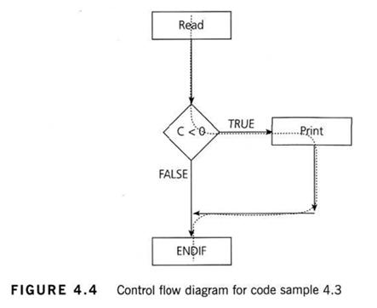
Decision coverage example con’t
Sometimes the decision structure is easier to see in a control flow diagram

Slide 51
The dotted line shows where Test 2_1 has gone and clearly shows that we haven’t yet had a test that takes the False exit from the IF statement.
Let’s modify our existing test set by adding another test:
TEST SET 2
Test 2_1: A = 20, B = 15
Test 2_2: A = 10, B = 2
This now covers both of the decision outcomes, True (with Test 2_1) and False (with Test 2_2).
If we were to draw the path taken by Test 2_2, it would be a straight line from the read statement down the False exit and through the ENDIF.

Slide 52
Condition Coverage
This is closely related to decision coverage but has better sensitivity to the control flow.
However, full condition coverage does not guarantee full decision coverage.
Condition coverage reports the true or false outcome of each condition.
Condition coverage measures the conditions independently of each other.

Slide 53
How to measure coverage
Decide on the structural element to be used, i.e. the coverage items to be counted
Count the structural elements or items
Instrument the code
  Implies inserting code alongside each structural element in order to record when that structural element has been exercised
Run the tests for which coverage measurement is required
Using the output from the instrumentation, determine the percentage of elements or items exercised
  Determining the actual coverage measure is a matter of analyzing the recorded information

Slide 54
Benefits of code coverage
It creates additional test cases to increase coverage
It helps in finding areas of a program not exercised by a set of test cases
It helps in determining a quantitative measure of code coverage, which indirectly measure the quality of the application or product.

Slide 55
Drawbacks of code coverage
One drawback of code coverage measurement is that it measures coverage of what has been written, i.e. the code itself; it cannot say anything about the software that has not been written.
If a specified function has not been implemented or a function was omitted from the specification, then structure-based techniques cannot say anything about them it only looks at a structure that is already there.

Slide 56
Use case testing
Use Case Testing: A technique that helps us identify test cases that exercise the whole system on a transaction by transaction basis from start to finish
A use case is a description of a particular use of the system by an actor (user of the system)
Each use case describes the interactions the actor has with the system in order to achieve a specific tasks (or, at least produce something of value to the user)
Actors are generally people but they may also be other systems
Use cases are a sequence of steps that describe the interactions between the actor and the system
Use cases are defined in terms of the actor, not the system, describing what the actor does and what the actor sees rather than what inputs the system expects and what the system’s outputs are.
They often use language and terms of the business rather than technical terms, especially when the actor is a business user

Slide 57
More on Use Cases
They serve as the foundation for developing test cases mostly at the system and acceptance levels
Use cases can uncover integration defects
  Defects caused by the incorrect interaction between different components
  Used in this way, the actor may be something that the system interfaces to such as a communication link or sub-system
Use cases describe the process flows through a system based on its most likely use
  This makes the test cases derived from use cases particularly good for finding defects in the real-world use of the system
Each use case usually has a mainstream (or most likely) scenario and sometimes additional alternative branches (covering, for example, special cases or exceptional conditions)
Each use case must specify any preconditions that need to be met for the use case to work
Use cases must also specify post conditions that are observable results and a description of the final state of the system after the use case has been executed successfully.

Slide 58
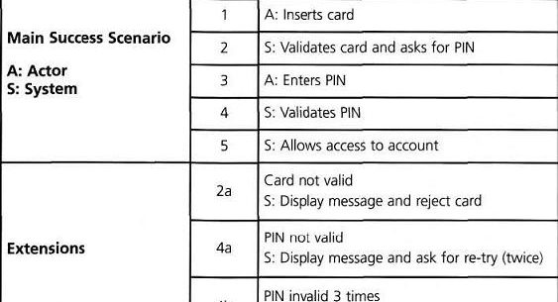
Use Case Example

Slide 59
White-Box or Structure-Based Testing Techniques
Structure-based testing technique: AKA White-Box or Glass-Box testing technique because here the testers require knowledge of how the software is implemented, how it works
In White-box testing, the tester is concentrating on how the software does it.
  Example: A structural technique may be concerned with exercising loops in the software
Different test cases may be derived to exercise the loop once, twice, and many times.
  This may be done regardless of the functionality of the software
Structure-based techniques can also be used at all levels of testing
  Developers use this in component testing and component integration testing, especially where there is good tool support for code coverage
Structure-based techniques are also used in system and acceptance testing, but the structures are different
  Example: The coverage of menu options or major business transactions could be the structural element in system or acceptance testing

Slide 60
Experience-Based Testing techniques
Experience-Based Testing Techniques: People’s knowledge, skills, and background are of prime importance to the test conditions and test cases.
The experience of both technical and business people is required since they bring different perspectives to the test analysis and design process.
Because of the previous experience with similar systems, they may have an idea as what could go wrong, which is very useful for testing.
Experience-based techniques go together with specification-based and structure-based techniques, and are also used when there is no specification, or if the specification is inadequate or out of date.
This may be the only type of technique used for low-risk systems, but this approach may be particularly useful under extreme time pressure – in fact this is one of the factors leading to exploratory testing.

Slide 61
Error Guessing
Error Guessing: A technique where the experienced and good testers are encouraged to think of situations in which the software may not be able to cope.
Some people seem to be naturally good at testing and others are good testers because they have a lot of experience either as a tester or working with a particular system and so are able to find out its weaknesses.
This is why an error guessing approach, used after more formal techniques have been applied to some extent, can be very effective. It also saves a lot of time because of the assumptions and guessing made by the experienced testers to find out the defects which otherwise won’t be able to find.
The success of error guessing is very much dependent on the skill of the tester, as good testers know where the defects are most likely to be.
This is why an error guessing approach, used after more formal techniques have been applied to some extent, can be very effective.

Slide 62
More on error guessing
Typical conditions to try include division by zero, blank (or no) input, empty files and the wrong kind of data (e.g. alphabetic characters where numeric are required).
If anyone ever says of a system or the environment in which it is to operate ‘That could never happen’, it might be a good idea to test that condition, as such assumptions about what will and will not happen in the live environment are often the cause of failures.
A structured approach to the error-guessing technique is to list possible defects or failures and to design tests that attempt to produce them.
  These defect and failure lists can be built based on the tester’s own experience or that of other people, available defect and failure data, and from common knowledge about why software fails.

Slide 63
Exploratory testing
Exploratory testing: is all about exploring, finding out about the software, what it does, what it doesn’t do, what works and what doesn’t work.
The tester is constantly making decisions about what to test next and where to spend the (limited) time.
This is an approach that is most useful when there are no or poor specifications and when time is severely limited.
Exploratory testing is a hands-on approach in which testers are involved in minimum planning and maximum test execution.
The planning involves the creation of a test charter, a short declaration of the scope of a short (1 to 2 hour) time-boxed test effort, the objectives and possible approaches to be used.
The test design and test execution activities are performed in parallel typically without formally documenting the test conditions, test cases or test scripts.
  This does not mean that other, more formal testing techniques will not be used.
  Example: The tester may decide to us boundary value analysis but will think through and test the most important boundary values without necessarily writing them down.
Test logging is undertaken as test execution is performed, documenting the key aspects of what is tested, any defects found and any thoughts about possible further testing.
It can also serve to complement other, more formal testing, helping to establish greater confidence in the software.
  In this way, exploratory testing can be used as a check on the formal test process by helping to ensure that the most serious defects have been found.

Slide 64
How to choose the best testing technique
Each technique is good in its own way in finding out the certain kind of defect, and not as good for finding out the other kind of defects.
Each individual technique is aimed at particular types of defect.
There are both internal and external factors that influence the decisions about which technique to use to achieve the desired results

Slide 65
Internal factors for choosing testing technique
Internal Factors:
  Models used in developing the system– Since testing techniques are based on models used to develop that system, will to some extent govern which testing techniques can be used. For example, if the specification contains a state transition diagram, state transition testing would be a good technique to use.
  Testers knowledge and their experience – How much testers know about the system and about testing techniques will clearly influence their choice of testing techniques. This knowledge will in itself be influenced by their experience of testing and of the system under test.
  Similar type of defects – Knowledge of the similar kind of defects will be very helpful in choosing testing techniques (since each technique is good at finding a particular type of defect). This knowledge could be gained through experience of testing a previous version of the system and previous levels of testing on the current version.
  Test objective – If the test objective is simply to gain confidence that the software will cope with typical operational tasks then use cases would be a sensible approach. If the objective is for very thorough testing then more rigorous and detailed techniques (including structure-based techniques) should be chosen.
  Documentation – Whether or not documentation (e.g. a requirements specification) exists and whether or not it is up to date will affect the choice of testing techniques. The content and style of the documentation will also influence the choice of techniques (for example, if decision tables or state graphs have been used then the associated test techniques should be used).
  Life cycle model used – A sequential life cycle model will lend itself to the use of more formal techniques whereas an iterative life cycle model may be better suited to using an exploratory testing approach.

Slide 66
External factors for choosing testing technique
Risk assessment – The greater the risk (e.g. safety-critical systems), the greater the need for more thorough and more formal testing. Commercial risk may be influenced by quality issues (so more thorough testing would be appropriate) or by time-to-market issues (so exploratory testing would be a more appropriate choice).
Customer and contractual requirements – Sometimes contracts specify particular testing techniques to use (most commonly statement or branch coverage).
Type of system used – The type of system (e.g. embedded, graphical, financial, etc.) will influence the choice of techniques. For example, a financial application involving many calculations would benefit from boundary value analysis.
Regulatory requirements – Some industries have regulatory standards or guidelines that govern the testing techniques used. For example, the aircraft industry requires the use of equivalence partitioning, boundary value analysis and state transition testing for high integrity systems together with statement, decision or modified condition decision coverage depending on the level of software integrity required.
Time and budget of the project – Ultimately how much time there is available will always affect the choice of testing techniques. When more time is available we can afford to select more techniques and when time is severely limited we will be limited to those that we know have a good chance of helping us find just the most important defects.

Slide 67
Chapter review
Test Cases | Test Case Specification | Test Condition | Test Data
Test Procedure Specification | Test Script | Traceability | Black-Box Test Design Techniques
Experience-Based Test Design Techniques | Specification-Based Test Design Techniques | Structure-Based Test Design Techniques | White-Box Test Design Techniques
Boundary Value Analysis | Decision Table Testing | Equivalence Partitioning | State Transition Testing
Use Case Testing | Code Coverage | Decision Coverage | Statement Coverage
Structural Coverage | Structure-Based Testing | White-Box Testing | Error Guessing
Exploratory Testing

Slide 68
Sample exam questions
For sample exam questions for this chapter refer to pages 119 – 121 of the PDF titled:
‘ISTQB Reference Book.pdf’

